Slide 1
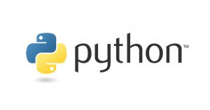
Carpenter Lab Python Workshop
Week 2
May 21, 2020
Practical Computing for Biologists
Chapter 7

Slide 2
Week 2 Goals
Understand the use of your terminal, Git Hub, Python, Anaconda, Spyder
Learn the basic syntax and understand the basic tools of programming
Learn difference between compiled and interpreted programs
That variables have several attributes, including name, type, and value
Important variable types (e.g. string, integer, float)
Using variable with operators
Create your first python script

Slide 3



Terminal Emulator
Terminal emulator
Windows
Git Bash
Cygwin
MobaXterm

Slide 4
Machine Code
Computers only understands a few basic commands
Basic arithmetic
Comparing two numbers
Loading a value from memory
Storing a value to memory
Computers understand binary
Notes:
Commands need to be given in the language the computer understand which is binary, which is a series of 1’s and 0’s.

Slide 5
Machine Code
Commands can differ by processor family
Each command will translate to a binary sequence
Data can also be converted into binary

Slide 6

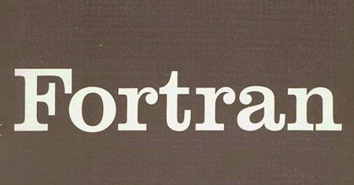


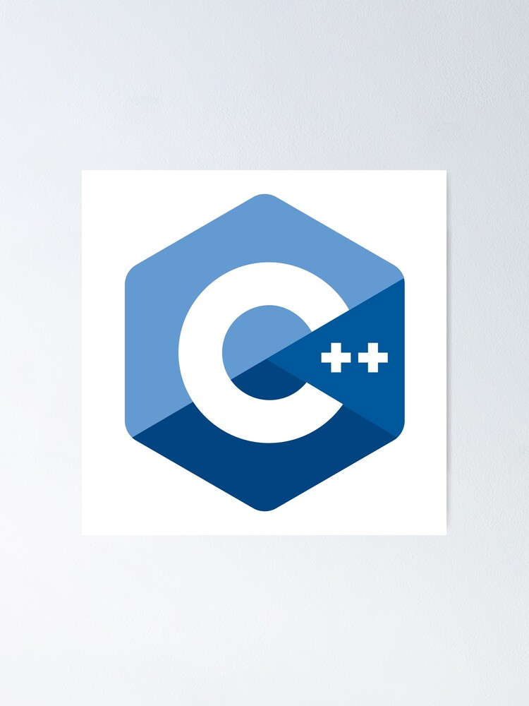

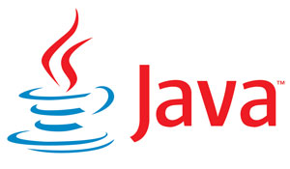


Programming Languages
Notes:
Higher-level programming languages: Commands expressed to a computer in a way that people can more easily comprehend. Programming languages are developed for people not computers. Fortran 1957 Cobol 1959 were developed to let people write code that was independent of any specific computer. Over time more languages were developed. Developed for people not computers. Allows programmers to structure our ideas and expressing them in a logical ordered way. Different langauges have different strengths

Slide 7
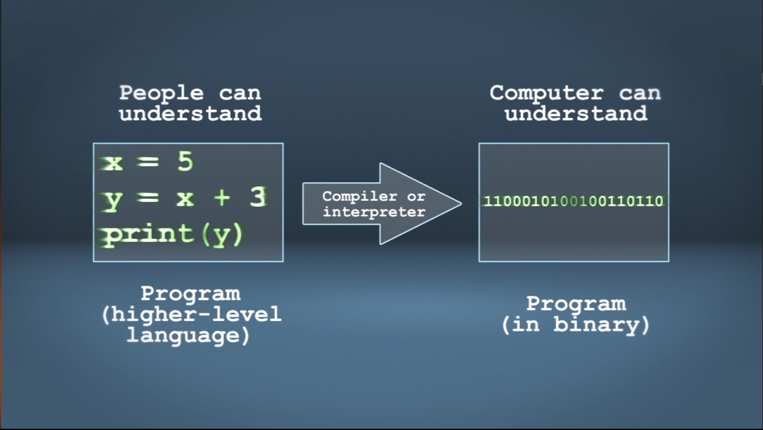

Slide 8
Programming Languages – Strengths/weaknesses
Easier to learn (Pascal)
Close relationship between the programming language and computer language (Fortran and C)
Easier for a person to read (COBOL)
Support a particular style of programming, i.e. object oriented programming (Java)
Easy to program in multiple styles (C++)
Specialized for a particular task
Databases (SQL)
Statistics (R)
Notes:
Strengths and weaknesses of every language

Slide 9
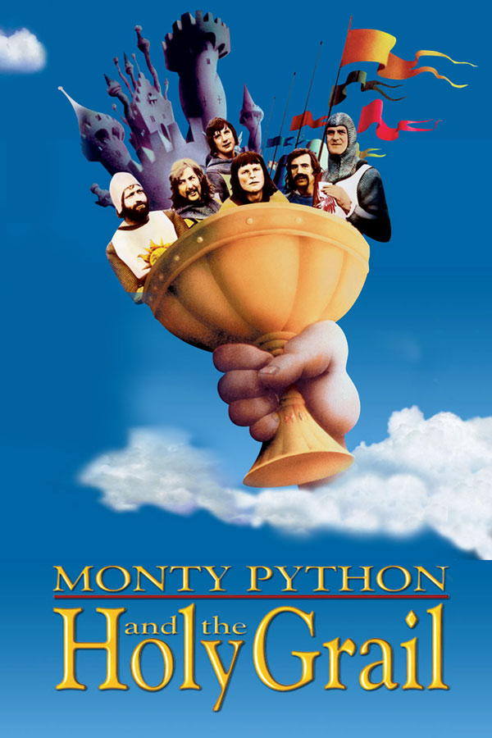
Python
General purpose language
Easy to put on your own computer
Relatively easy to learn
Powerful enough that it is used regularly on real world problems
Notes:
G

Slide 10
Translation
Interpreted languages
Compiled languages
Going line by line through a program and immediately converting it to machine instructions
Python, R, Matlab, Perl
Taking in the whole program at once to figure out the best machine instructions
C++, Basic, COBOL, Java Fortran, Pascal
Notes:
Analogy of a translator. Taking the program and converting them into machine instructions. Python is an interpreted language.

Slide 11
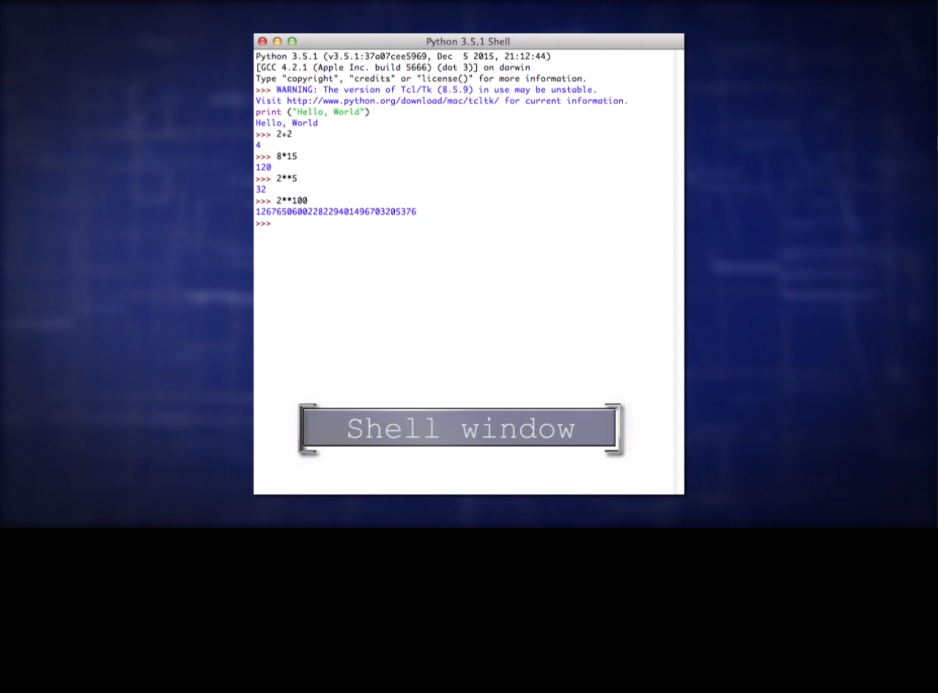

Slide 12
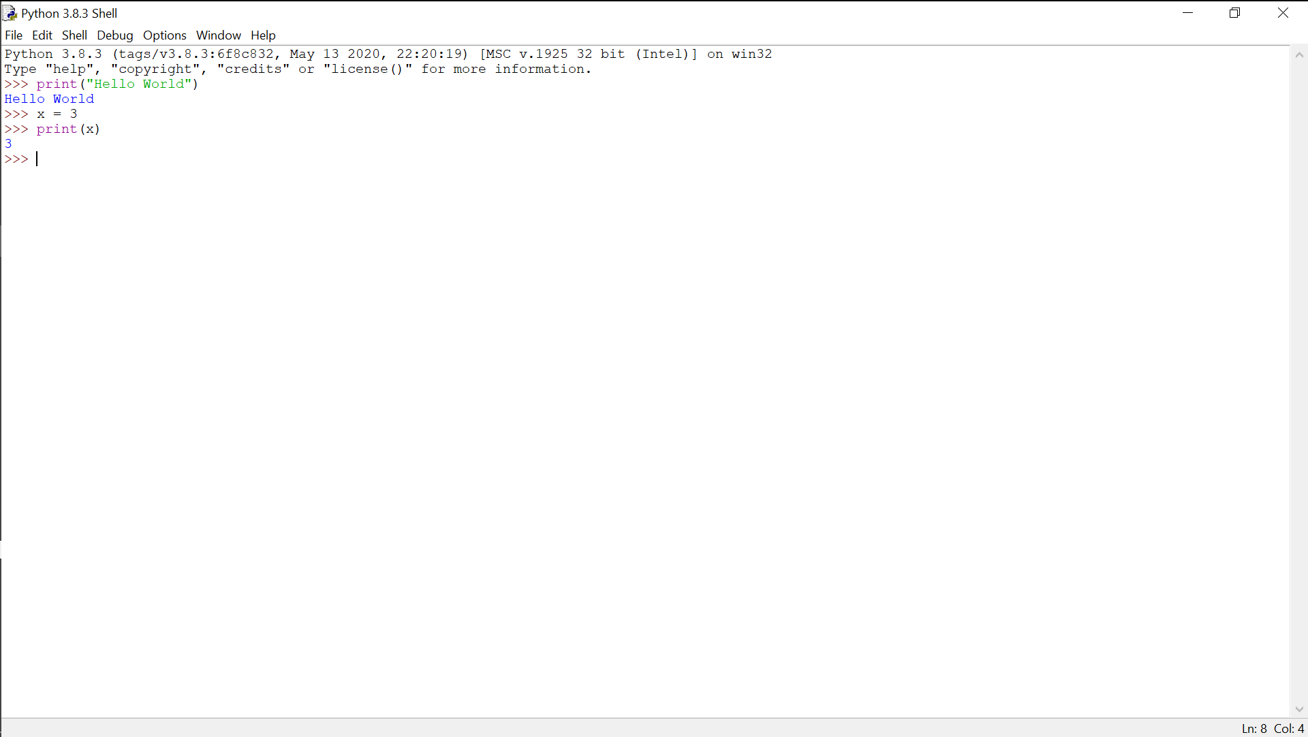
IDLE (Integrated Development and Learning Environment)
Interactive shell
Notes:
Any command typed into this window will be interpreted as a python command and executed

Slide 13
IDLE (Integrated Development and Learning Environment)
Interactive shell
Notes:
Any command typed into this window will be interpreted as a python command and executed

Slide 14
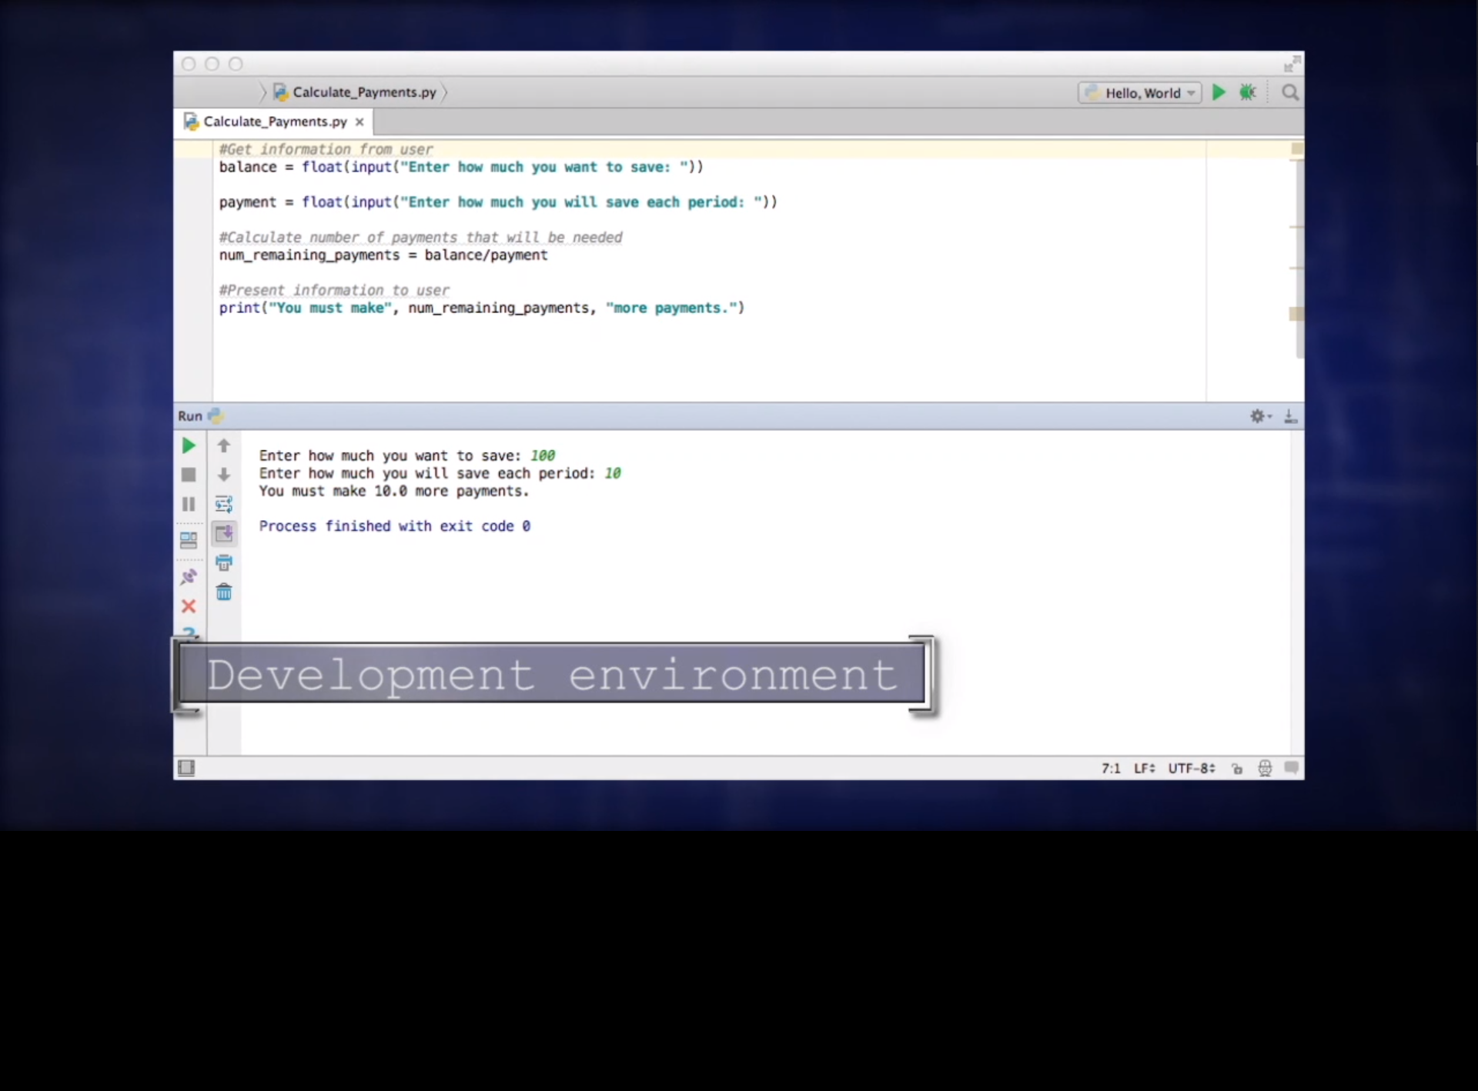

Slide 15
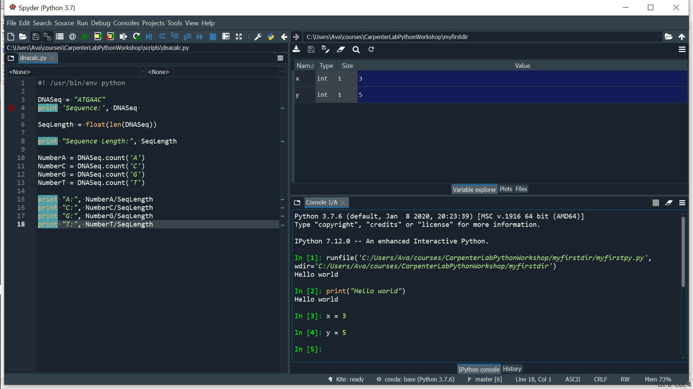

Spyder

Slide 16
Variable – name for a value
Can include letters, digits, and underscores
cannot start with a digit
are case sensitive
E.g. variable = value

Slide 17
Types of data
Type Example
Integer numbers 98
Floating point numbers 98.6
Character string ‘Homo sapiens’
Boolean True

Slide 18
Data type conversion
Value has the type, the variable is just the label
Integer (int)
Floating point number (float)
Character string (str)
Each position in the string is given a number, which is called an index or subscript
Indices start from 0
Use []
Part of a string is called a substring, which can be as short as a single character
An item in a list is called an element. Whenever we treat a string as if it were a list, the string’s elements are its individual characters.
A slice is a part of a string (or, more generally, any list-like thing).
Strings have length but numbers don’t

Slide 19
Conversions
float(“3.4”)
String to float
int(3.4)
Float to integer
float(3)
Integer to float

Slide 20
Functions – A subprogram that can be called repeatedly to perform the same task within a program
Function
print()
E.g. pring(something)
something
Nested functions
E.g. print(len())
Len is a built-in function
Evaluated inside out

Slide 21
Arguments - Values that are sent to a program at the time it is run

